Slide 1
FGI activity report on geodynamics 2007-2008
Ruotsalainen H., J. Mäkinen, M. Bilker- Koivula, M. Nordman, V. Saaranen,K.Arsov, J.Virtanen , H. Virtanen, M.Poutanen, J.Ahola, J. Puupponen

Slide 2
Content
Absolute gravimetry
Relative gravimetry
Superconducting gravimetry
Satellite gravimetry
Watertube tiltmeter
VLBI
GPS
SLR
DynaQlim

Slide 3
Absolute gravimetry
International campaigns
Mäkinen
  - Russia 2 stations
  Iceland 8 stations
  Poland 3 stations
  Lithuania 1 station
  Latvia 1 station
National campaigns
Bilker-Koivula
- Metsähovi, Vaasa AA,AB, Joensuu
International comparisons in 2007
Metsähovi: 12.3. – 16.3. FG5-233 LMV /FG5-221 FGI
Metsähovi: 30.6. – 6.7. FG5-220 IfE / FG5-221 FGI
Walferdance: International Comparison of Absolute Gravimeters ICAG2007

Slide 4
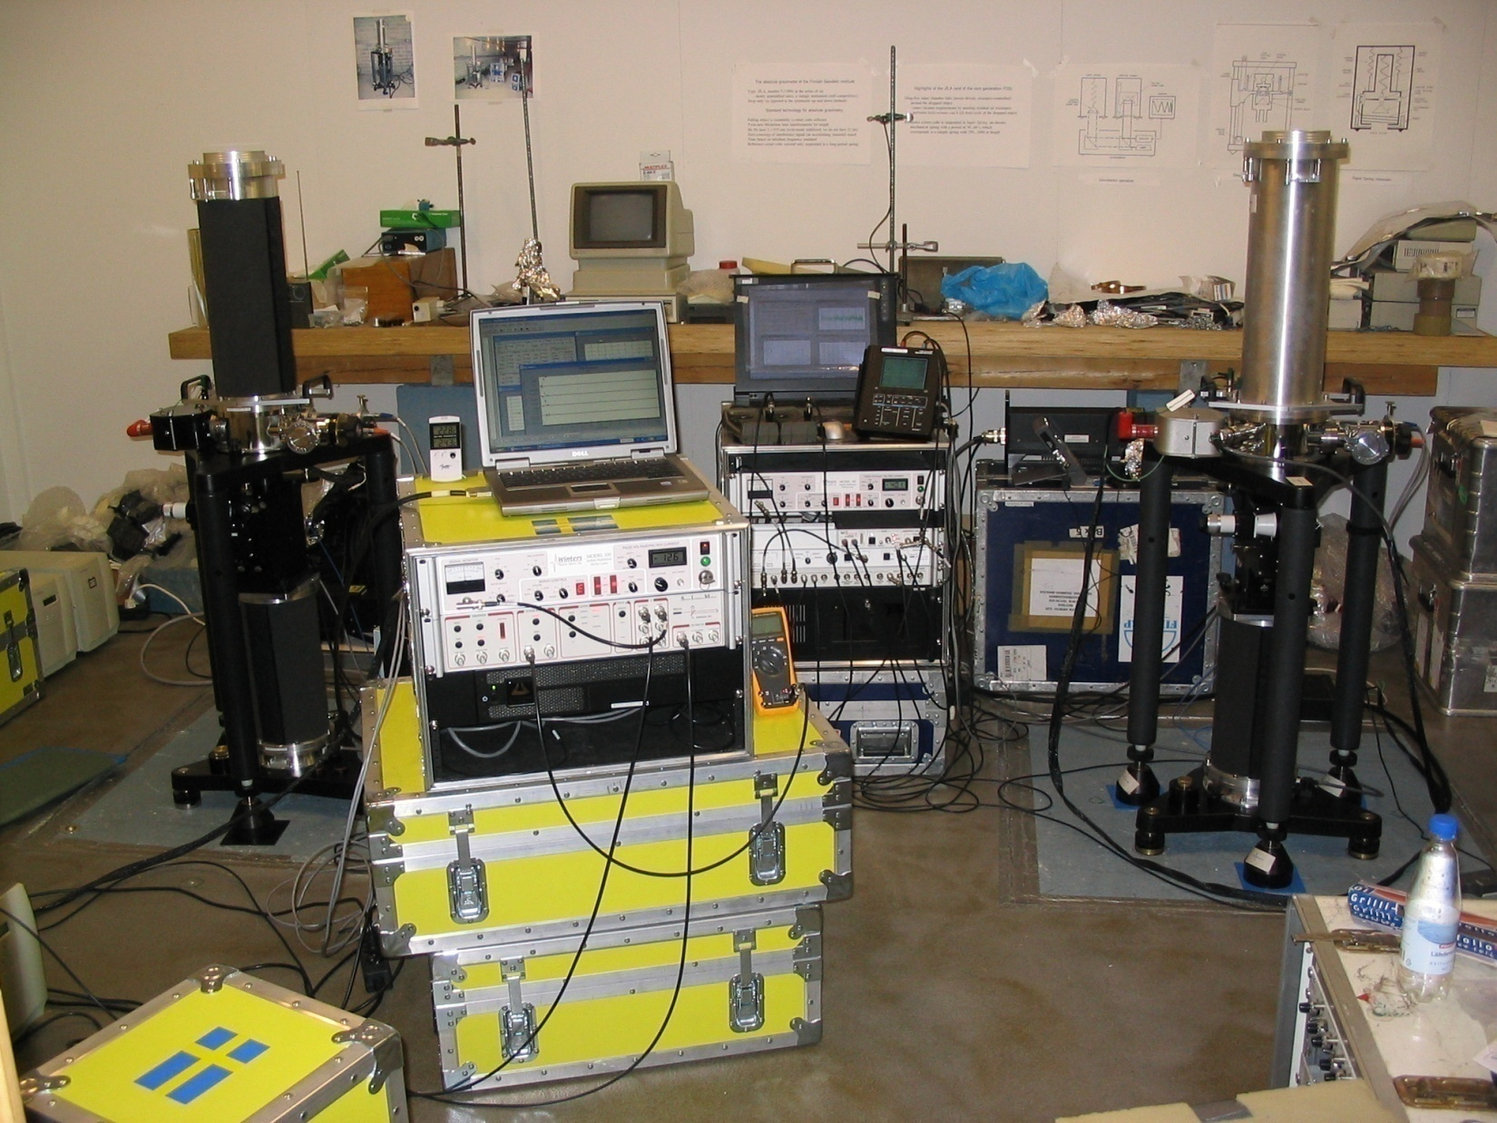

Slide 5
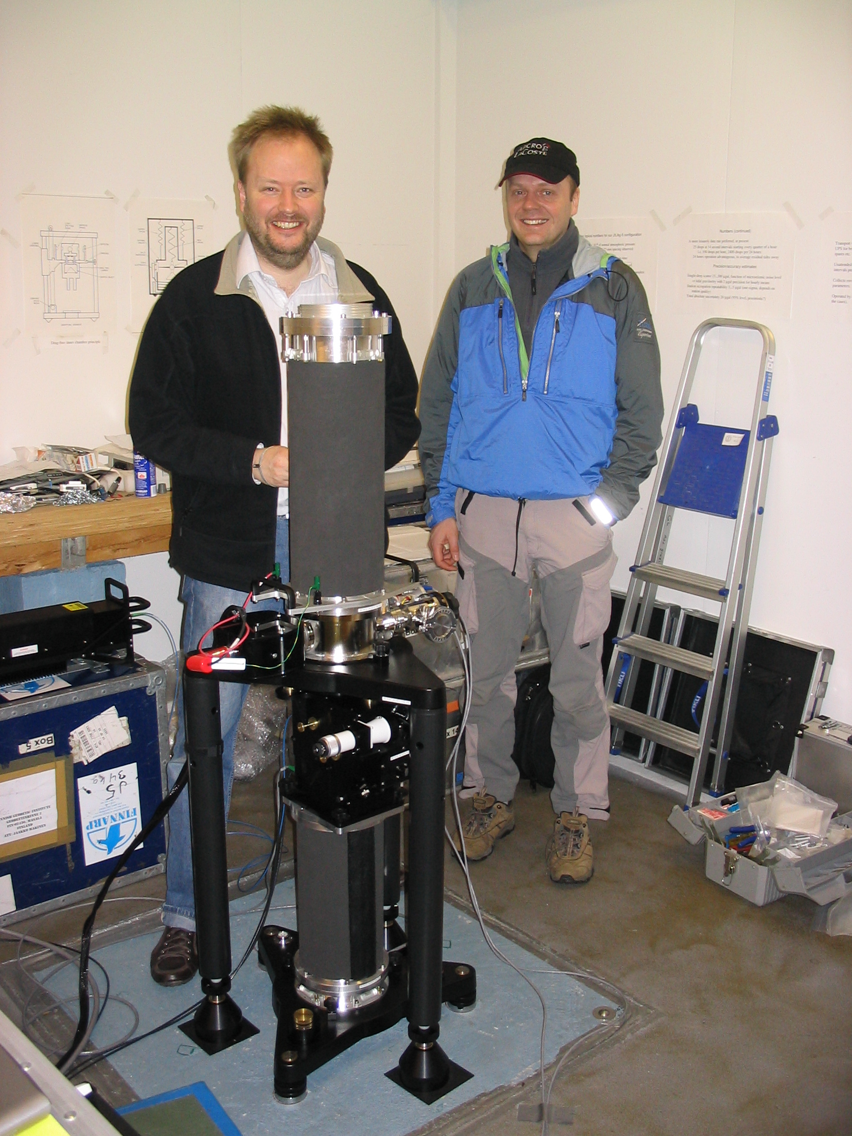

Slide 6
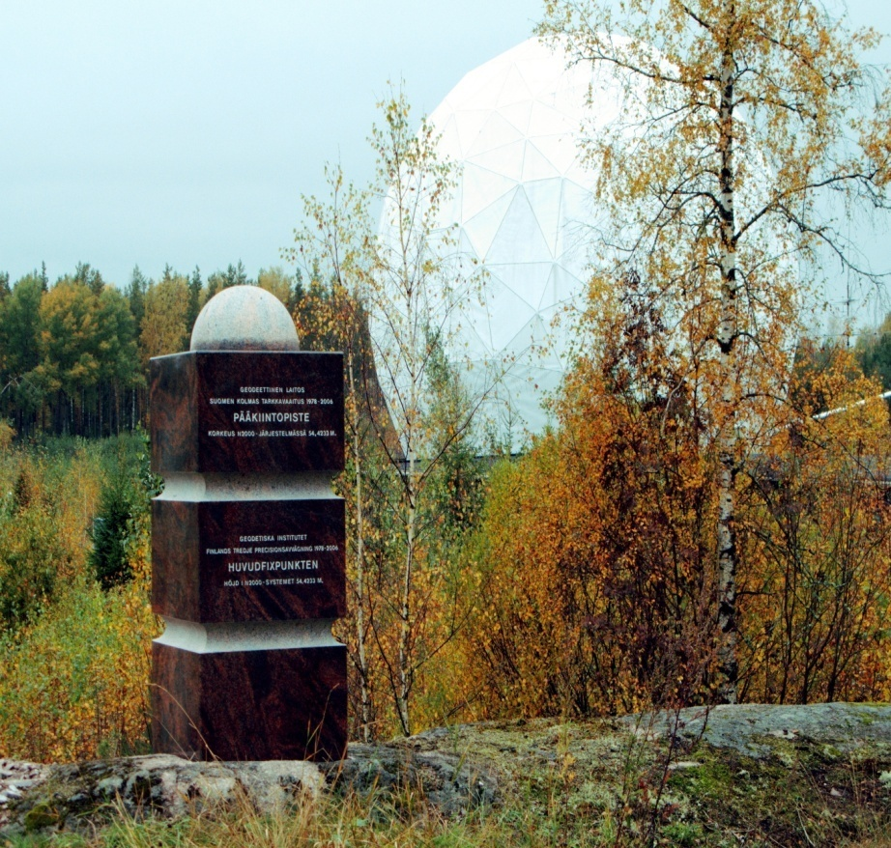
Relative gravimetry
Gravity were determined for the Fundamental benchmark of the Third levelling of Finland at Metsähovi
Gravity were measured by FGI in the Department of Physical Sciences of the Helsinki University

Slide 7
Satellite gravimetry
  J. Virtanen et al. Compared GRACE modelling with regional and local water storage models:
  Baltic Sea model (Finnish Institute of Marine Research)
  WSFS (Watershed Simulation and Forecasting system) of the Finnish Environment Institute) model

Slide 8
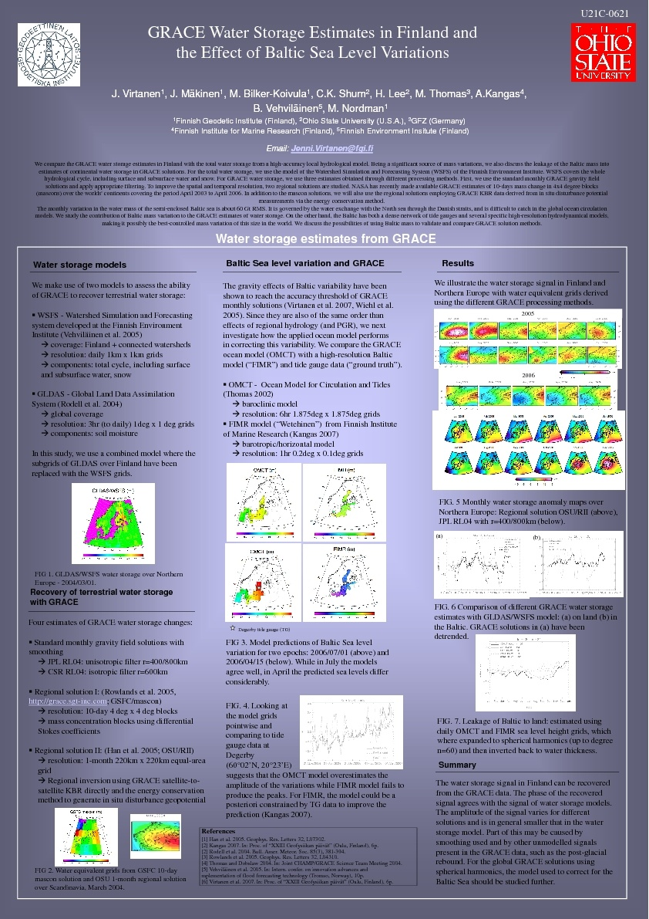

Slide 9
Superconducting gravimetry, Metsähovi

Slide 10
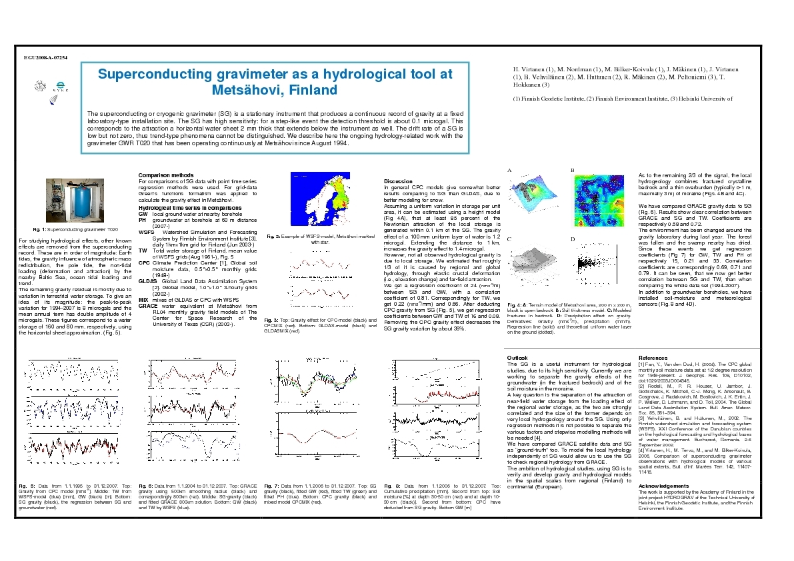
Superconducting gravimetry Metsähovi

Slide 11
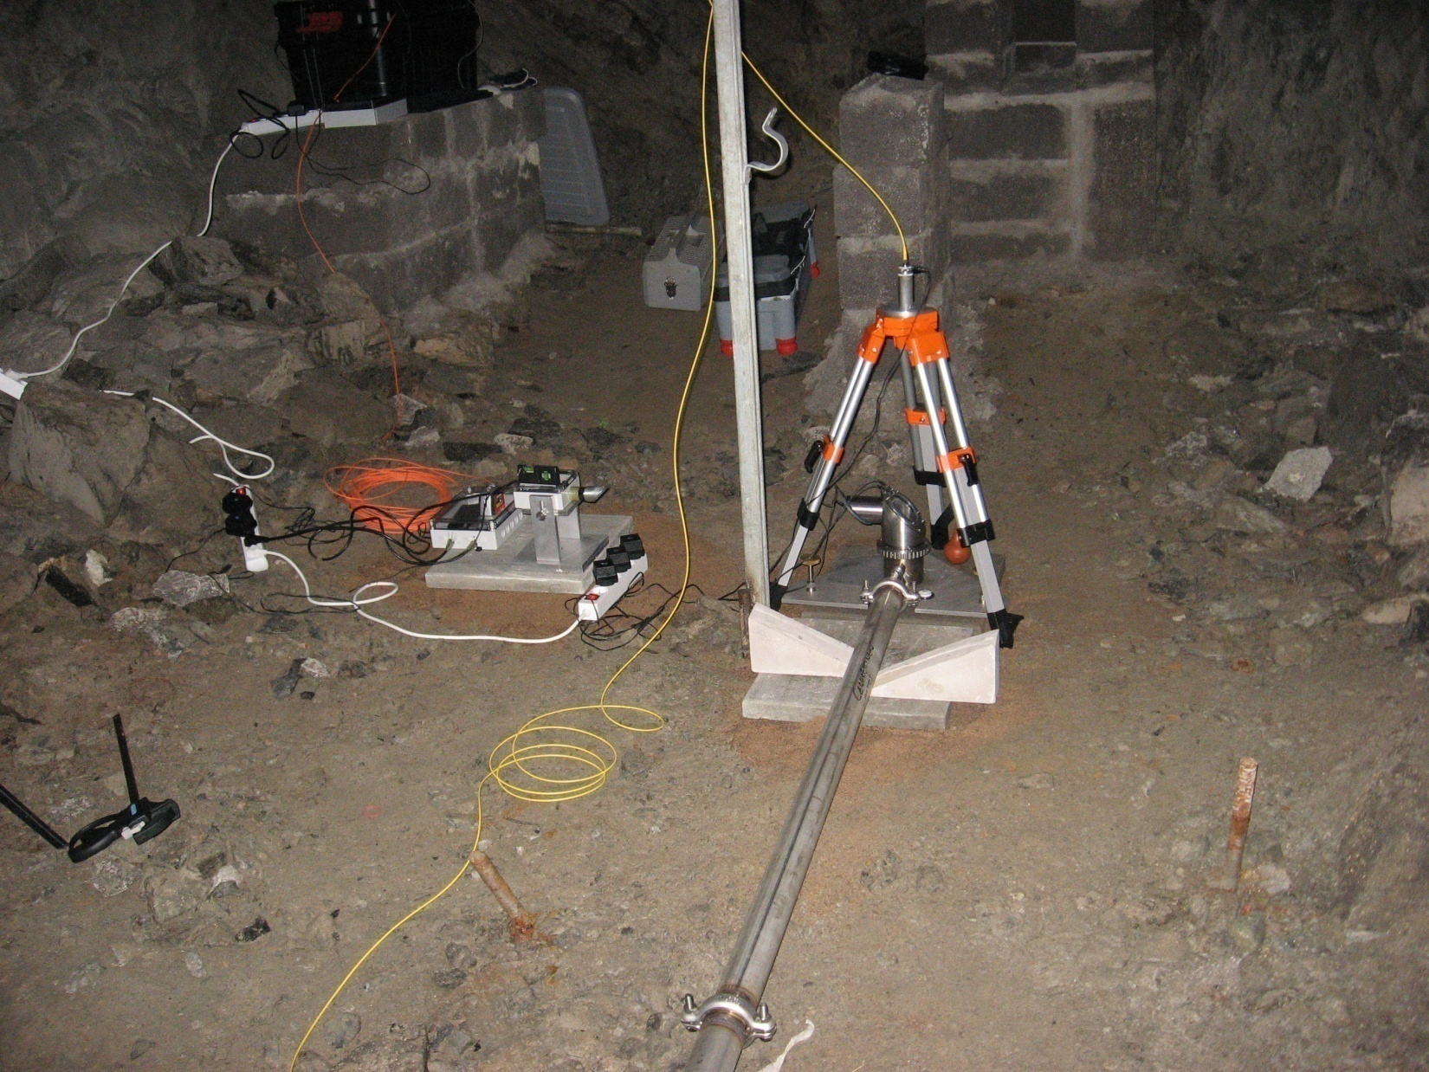
New 50.4 m long NSWT in Lohja mine (20 km west from Metsähovi)
50.4 meter NSWT built in Oct-Dec 2007
Tube and pots directly on bedrock with sand,concrete plates and triangle bricks
2

Slide 12
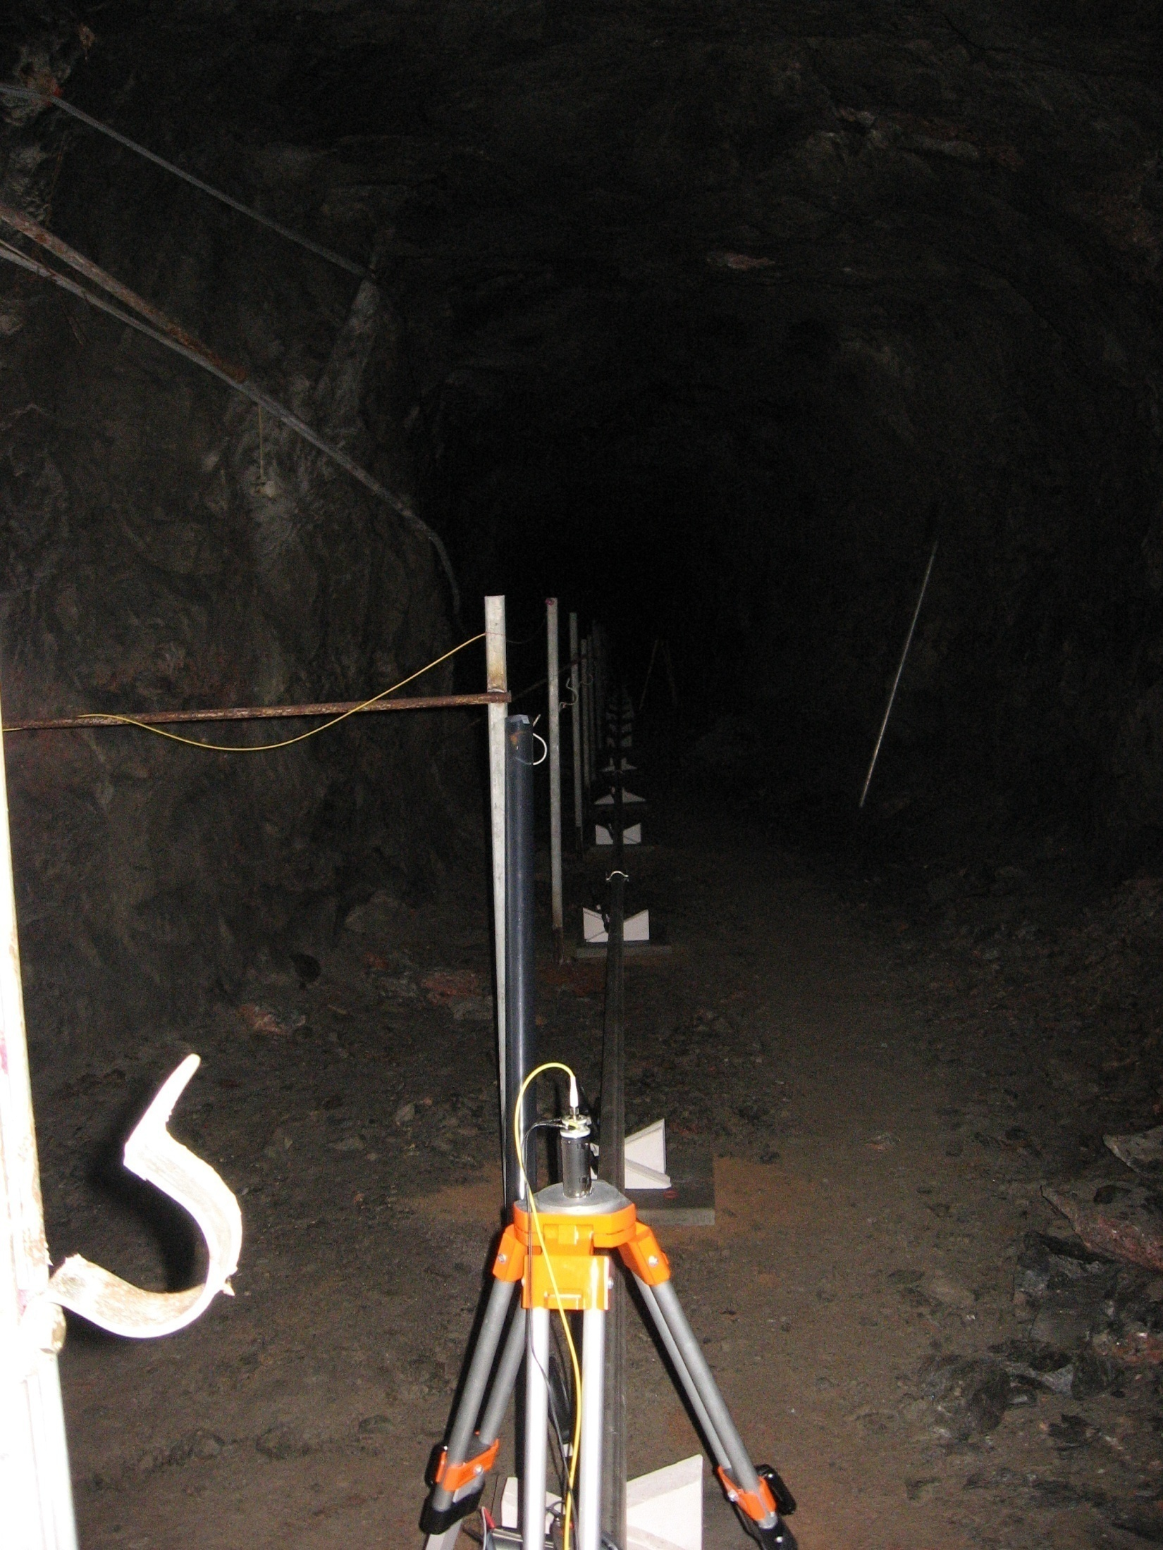

Slide 13
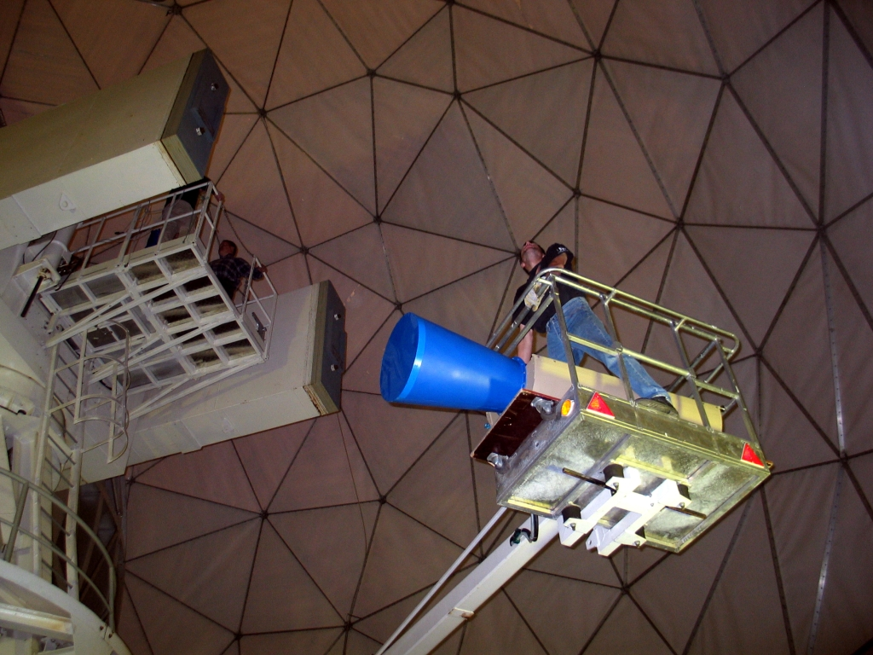
Geodetic-VLBI
  Geodetic- VLBI
  FGI/HUT team in Metsähovi participated on 8 geodetic VLBI campaigns in 2007 and 2 in the beginning of 2008.
2

Slide 14
Local crustal deformation measurements
  -
  Precise GPS network measurements and optical distance measurements continued 2007 in the vicinity of nuclear power plant Olkiluoto in south-western Finland
  Repeated GPS measurements in possible nuclear waste location sites Olkiluoto, Kivetty and Romuvaara

Slide 15
SLR Metsähovi
K. Arsov is developing a new Satellite Laser Ranging system in Metsähovi with kHz laser system. Telecope, recording facility and observation building are going to be renovated.

Slide 16
DynaQlim
DynaQlim –Upper mantle Dynamics and Quaternary Climate in Cratonic areas directed by M.Poutanen had a national meeting in Dec. 2007 and international meeting in Jan 2008 in Copenhagen.

